Slide 1
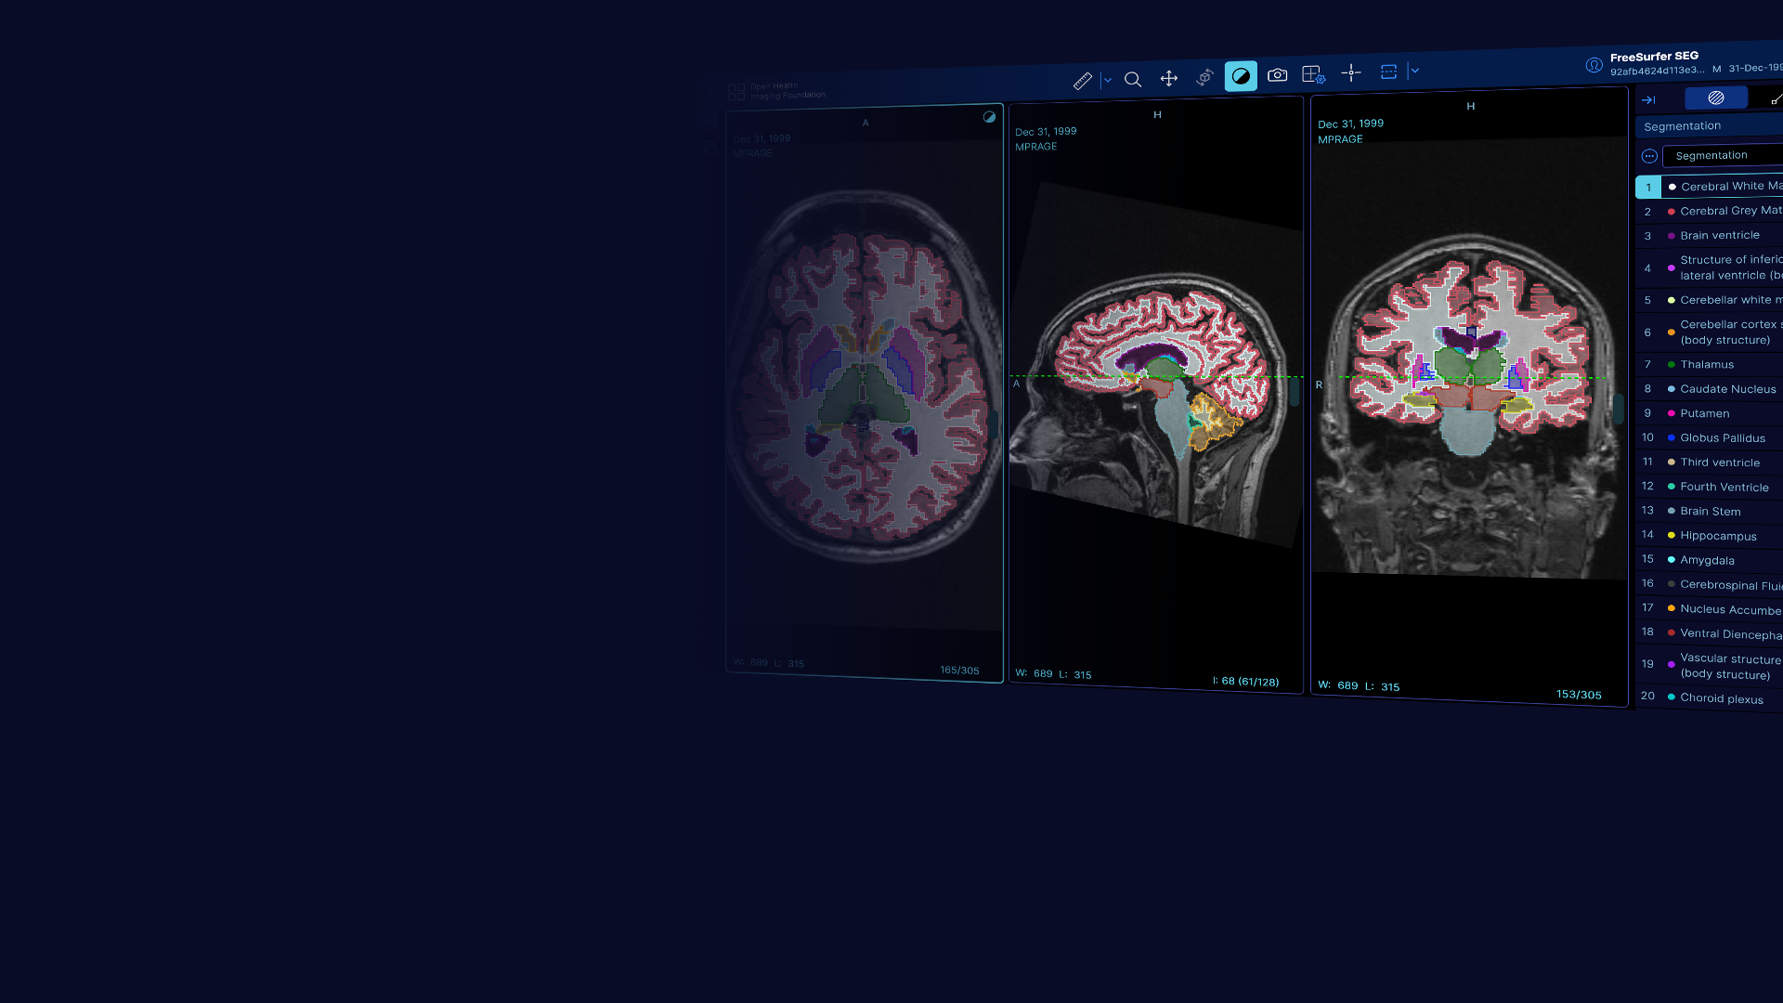



Advisory Board Meeting
September 22, 2026

Slide 2
Funding Update
R03 Year 2
  0.5 FTE developer:
    FHIRcast extension (available now in OHIF 3.13), dcmjs 1.0 (next release in OHIF 3.14)
  O.5 FTE developer:
    Continual automated test coverage expansion
ITCR Year 4
  Year 4 began May 1
  0.8 FTE developer and 0.25 QA tester
  Set-aside project with FU Berlin: ~ 4 months 1 FTE total
Potential Funding
  OS4LS - submitted proposal for 2 years, $1m
    Collaboration with IDC to create web-based, agentic friendly shared annotation repository
    OHIF listed as collaborator on Slicer proposal (also for 2 years, $1m)

Slide 3
Action Based on Advisory Board Feedback May 2026
Enabling Community Development
  Updated contribution guidelines for automated testing
  Created AI skill for community use when contributing tests
  In progress:
    Update public community guideline docs website
    New contributor guidelines focused on enabling automation in PR review
Engagement and Marketing
  Approved proposal to re-brand and market OHIF
    Focus on brand awareness of the foundation and supported libraries
    Re-launch social media and community campaigns with content updates, guides, etc
Extensibility
  Added customization handler via URL parameter (#5992)
  In progress:
    Simplify OHIF extension and mode creation (#6168)

Slide 4
OHIF 3.14 - Expected Release Late 2026
Overview
OHIF ‘tablet mode’ prototype
  Collaboration with FU Berlin
  Performance improvements for low end devices, improved small screen UI support
Substantially increased automated test coverage
  Projected to be >60% coverage, moving towards goal of 80%
React 19 upgrade
  Faster load, simpler components, better support
Updated codecs
  HTJ2K performance, JPEG-XL quality, bug fixes, cleaner build setup
dcmjs support
  Substantial rework (1.0 beta release), performance, and quality of life improvements
Currently in development.

Slide 5
Discussion: OHIF ITCR Funding Renewal
Current 5 year NIH ITCR U24 funding ends April 2028
ITCR wants to know:
Application for 5 year renewal due June 2027. Proposals should include:
Forward looking innovations for the community
Clearly defined AI strategy
Sustainment plan for OHIF after ITCR funding ends
We want to hear your perspective about the future of OHIF.
What priorities would you like to see OHIF focus on over the next 5 years?
What does OHIF not do now that it should do in the future?
How can OHIF better support and interact with the imaging community at large?

Slide 6
Discussion: Other Long Term Sustainment Funding
OHIF has a need to broaden sustainment funding opportunities beyond ITCR.
Examples of non-ITCR funding OHIF has secured:
Other grants
  Chan Zuckerberg Initiative (2019-21, 2021-23)
Industry collaboration
  Partnered with major CRO to develop CS3D tools (2023-24)
Research
  Developed ultrasound mode with Brigham and Women’s Hospital (2025)
OHIF briefly registered as a 501(c)(3) but decided against it due to upkeep (2016)
What are your thoughts on pursuing these types of funding opportunities?
How would you like to see OHIF funded in the future to best serve our community?

